Slide 1
Chapter 6-2 Recommendation
Dr. Dai Yu

Slide 2
Why Recommendation?
Recommender systems are widely used on the web for recommending products and services to users.
Most e-commerce sites have such systems.
These systems serve two important functions.
They help users deal with the large amount of information
They help business make more profits, e.g. selling more products

Slide 3
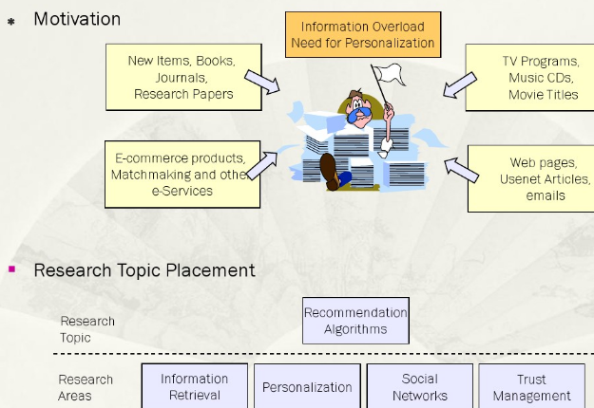
Motivation

Slide 4
Movie Recommendation
The most common scenario is the following:
A set of users has initially rated some subset of movies that they have alread seen.
These ratings serve as the input. The recommendation system uses these known ratings to predict the ratings that each user would give to those not rated movies by him.
Recommendations of movies are then made to each user based on the predicted ratings.

Slide 5
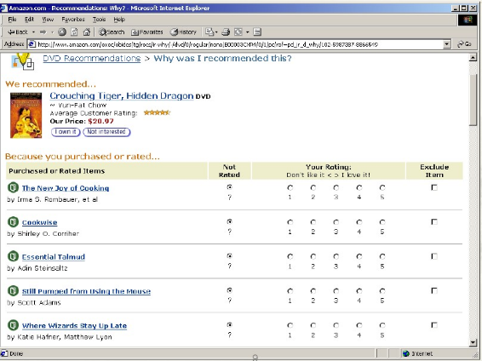

Slide 6
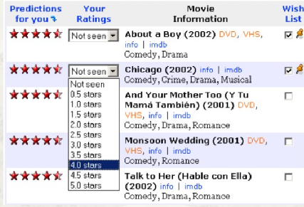

Slide 7
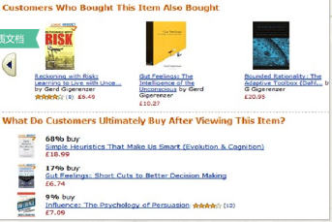
What book should I buy?

Slide 8
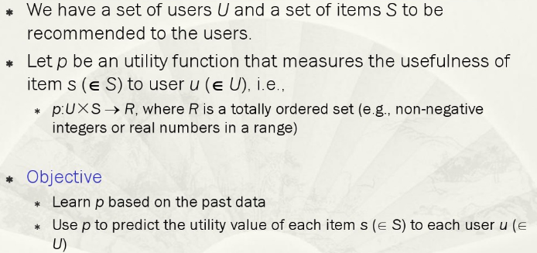
The Recommendation Problem

Slide 9
As Prediction
Rating prediction, predict the rating score that a user is likely to give to an item that he has not seen or used before.
rating on an unseen movie. In this case, the utility of item s to use u is the rating given to s by u.
Item prediction, predict a ranked list of items that a user is likely to buy or use.

Slide 10
Basic Methods
Content based recommendations
The user will be recommended items similar to the ones the user preferred in the past;
Collaborative filtering
The user will be recommended items that people with similar tastes and preference
Hybrids

Slide 11
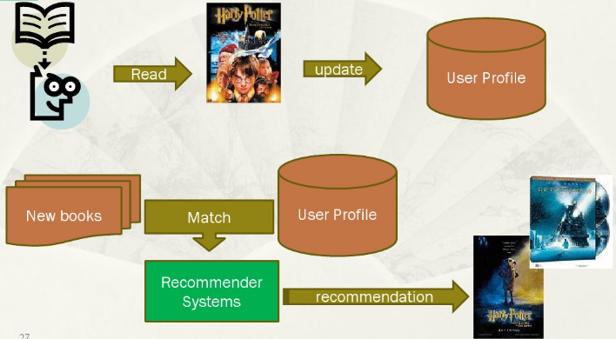
Content based recommendations

Slide 12
Content based recommendations LIBRA
Content based recommender for books using information about titles from amazon
Use information extraction from the web to organize text into fields
Author
Title
Editorial Reviews
Customer Comments
Subject Terms
Related Authors

Slide 13
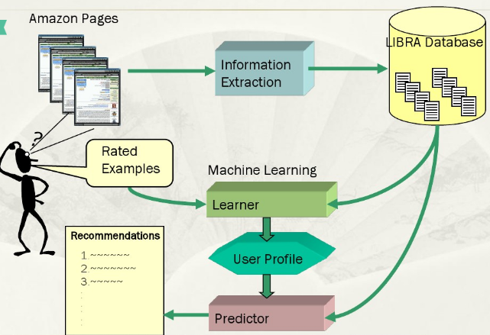
LIBRA

Slide 14
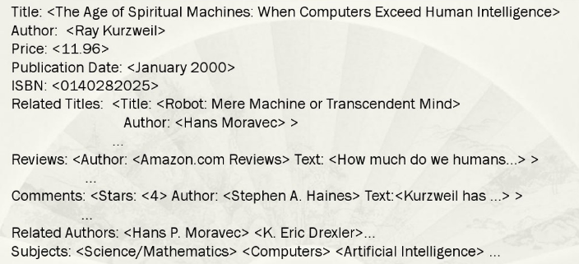
Sample extracted Information

Slide 15
LIBRA Content Information
Libra uses this extracted information to form “bag of words”
Author
Title
Description
Subjects
Related Titles
Related Authors

Slide 16
Highlights
Recommend items similar to those users preferred in the past
User profilling is the key
Items/content usually denoted by the keywords
Matching “user preferences” with “item characteristics”
Vector space model widely used

Slide 17
Limitations
Not all content is well represented by keywords, e.g. images
Items represented by same set of features are indistignushable
Overspecificalization: unrated items not shown.
Users with thousands of purchases is a problem
New User: No history available

Slide 18
Collaborative Filtering
Collarborative filtering is perhaps the most studied and also the most widely-used recommendation method in practice.
k-nearest neighbor
association rule based prediction
matrix factorization
Key characteristics: it predicts the utility of items for a user based on the items previously rated by other like-minded users.

Slide 19
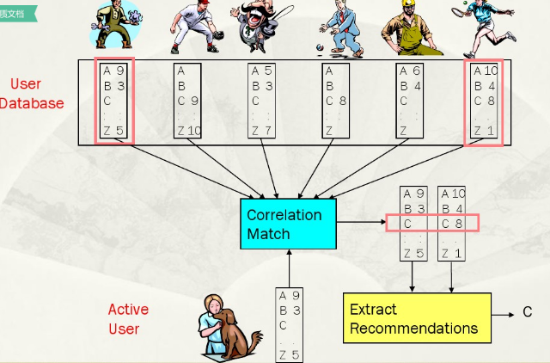
Collaborative Filtering

Slide 20
Examples
Bestseller lists
Top 40 music lists
Recent returns shelf at the library
Popular weblogs
Read any good books lately?
Common insight
Personal tasts are correlated
If A and B both like X and A likes Y then B is likely to like Y

Slide 21
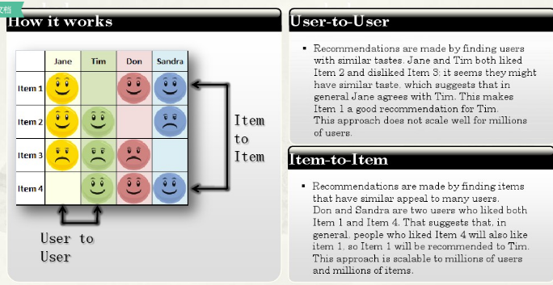
People whol liked this also liked

Slide 22
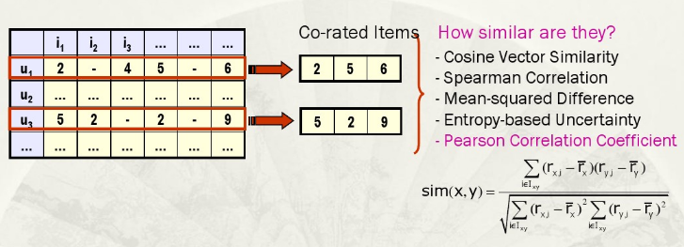
Collaborative Filtering

Slide 23
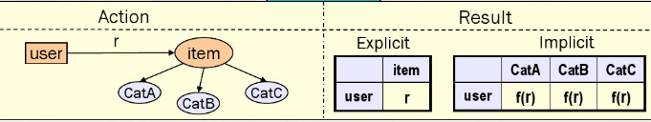
Rating Activity
Explicit Rating
A rating that expresses the preference of a user to a specific item
Implicit Rating
Each explict rating of a user to a specific item implicitly identifies the user's preference to the categories that this item belongs to

Slide 24
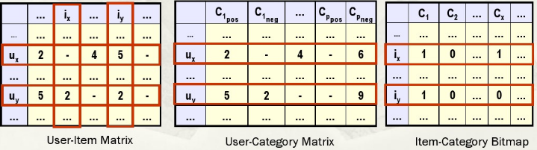
Similarity Meausres
Distinctions
User-based vs. Item based similarity
Explicit Rating vs. Implicit Rating
Definition of three matrices
User-item,User-Category, Item-Categor

Slide 25
Prediction Algorithm Prediction=Average+Ajustment
User-based
CF_{UB-ER}: Explicit Rating
CF_{UB-ER-CB}: Explicit Rating, Content Based
CF_{UB-IR}: Implicit Rating
Item-based
CF_{IB-ER}: Explicit Rating
CF_{IB-IR}: Implicit Rating

Slide 26
k-Nearest Neighbor
KNN utilizes the entire user-item databased to generate predictions directly, i.e. there is no model build
This method includes
User-based methods
Item-based methods

Slide 27
User-based KNN CF
A user-based KNN collaborative filtering method consists of 2 phases
the neighborhood formation phase
the recommendation phase
There are many specific methods for both.

Slide 28
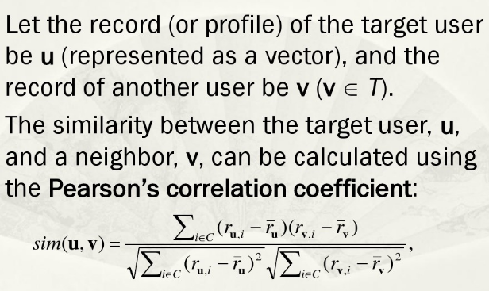
Neighborhood formation phase

Slide 29
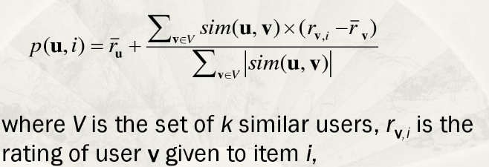
Recommendation Phase
Use the following formula to compute the rating prediction of item i for target user u

Slide 30
Item based CF algorithm
Looks into the set of items the target user has rated & computes how similiar they are to the target item and then selects k most similar items.
Prediction is computed by taking a weighted average on the target user'sratings on the most similar items

Slide 31
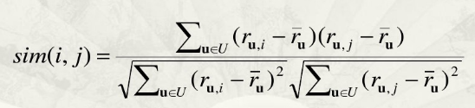
Item-based CF
The item-based method works by comparing items based on their pattern of ratings across users. The similarity of items i and j is computed as follows

Slide 32
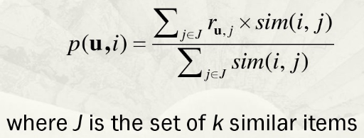
Recommendation Phase
After computing the similarity between items we select a set of k most similar itemsto the target itm and generate a predicted value of user u's rating

Slide 33
Highlights
Use other users recommendations to judge item's utility
Key is to find users whose interests match with the current user
Vector space mode widely used
More users, more ratings: better rsults

Slide 34
Limitations
Finding similar users isnot very easy
Cold start problem
Multi-criteira ratings is required

Slide 35
Other Variations
Cluster models
Create clusters
put a custormer into a category
Classification simplifies the task of user matching
More scalability and performance
Less accuracy than normal collaboratfiltering

Slide 36
Association Rule Based Recommendation
Association rules obviously can be used for recommendation
Each transaction for association rule minis the set of items bought by a particular user
We can find item association rules
buy_X, buy_Y-> Buy_Z
Rank items based on measures such as confidence

Slide 37
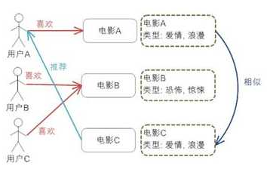
Comparison Between Content-based and Collaborative Filtering
Content-based
Like
Movie A
Love & Romantic
Recommend
Like
Movie B
Thrill
Similar
Like
Movie C
Love, Romantic & Action

Slide 38
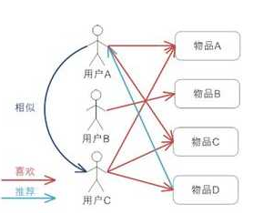
Comparison Between Content-based and Collaborative Filtering
Collaborative Filtering
User-User
Item A
Item B
Similar
Item C
Like
Recommend
Item D

Slide 39
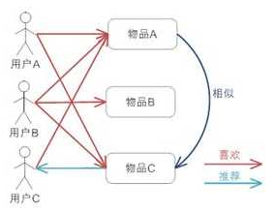
Comparison Between Content-based and Collaborative Filtering
Collaborative Filtering
Item-Item
Item A
Item B
Similar
Like
Item C
Recommend

Slide 40
Hybrid Recommendation
Combination of multiple recommendation techniques together for producing output
Content+collaborative filtering
Different techniques of different types
most common implementations
Most promise to solve cold-start problem

Slide 41
Combining Content and Collabortion
Content based and collaborative methods have complementary strenghts and weaknesses
Combine methods to obtain the best of both
Various hgybrid methodes:
Apply both methods and combine recommendations
use collaborative data as content
use content based predictor to complete collaborative data

Slide 42
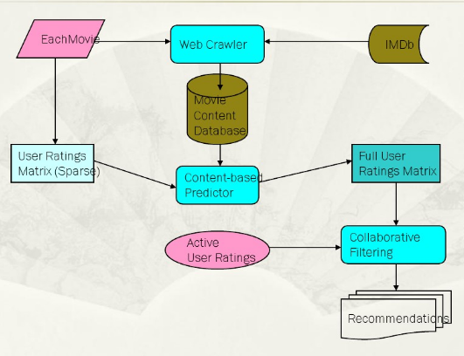
Content-Based Collaborative Filtering

Slide 43
Context Based Recommendation
The recommendaer system uses additional data about the context of an item consumption
Example
A restaurant recommendation for a saturday evening when you go with your spous should be different than a restaurant recoomendation on a workday when you go with your co-worker.

Slide 44
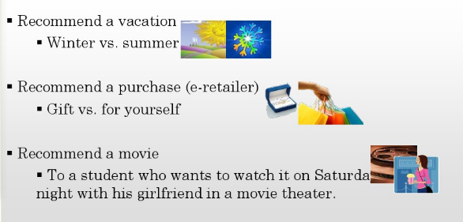
Motivation Example

Slide 45
What simple recommendation techniques ignore?
What is the user doing when asking for a recommendation?
Where and when the user is located?
What does the user really want?
Is the user alone or with other fellows?

Slide 46
Major Obstacle for context computing
Obtain sufficient and reliable data describing the user context
selecting the right information
understand the impact of content dimensions on the personalization process

Slide 47
Trust/Social Based Recommender
Users tend to recieve advice from people they trust
Trusted friends can be defined explicitly by the user or inferred from social networds they are registered to

Slide 48
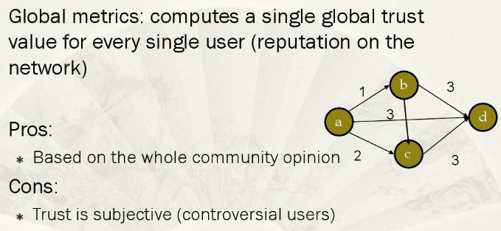
Trust Metrics

Slide 49
Key Issues
Cold Start
Multiplicity of the results
Categories
Time Series
Context
Show of the results
select appropriate features
Community
Interest community
Response Time
Explaination to the recommended result
Ambigurity of the requirements

Slide 50
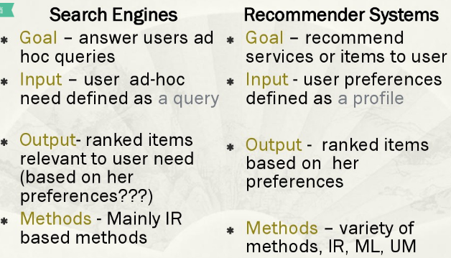
Personalized Web Search

Slide 51
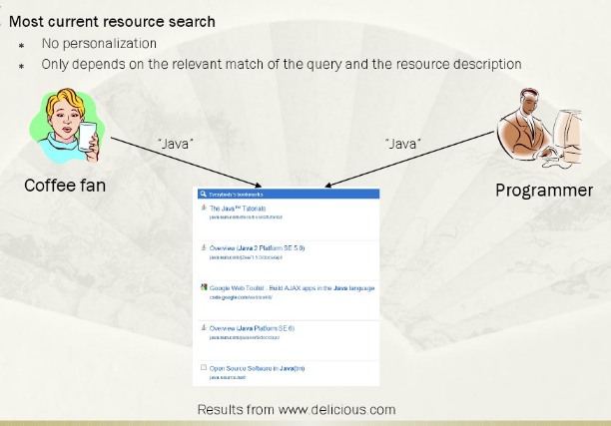
Why Personalization

Slide 52
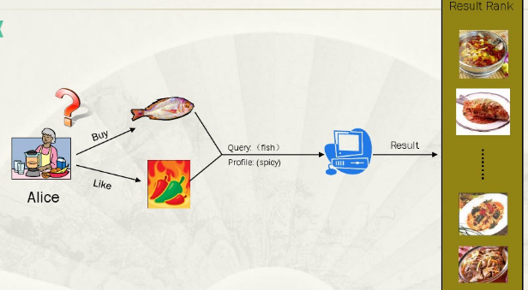
Another Scenario

Slide 53
Next Generation of Web Search
Guess
From the experience of yourself
Search in vedio/image
I want to know where is the key in the vedio
Intelligence is still a big problem
Except keywords what can be used to express the user's requirement

Slide 54
Exam
1 Construct a data structure to store the inverse index. Give the inverse index of the following document.
DOC1 a new mechanism for optimizing service composition on the web
DOC2 service composition is a promising web application.
DOC3 service composition is to compose the distributed services on the web
DOC4 service economy has gained much attention

Slide 55
Exam
2 Based on the constructed inverse index，design an algorithm to implement bool retrieval. Based on this algorithm, give the result when the query is “service composition AND web AND NOT optimization“。
3 Present at least 2 optimization policies for the bool retrieval based on inverse index. Take any one of the policy, give the detailed algorithm in this policy.

Slide 56

Exam
4 Please use single link and complete link methods to cluster the data points in the following.

Slide 57
Exam
5 Please illustrate the process of extract the news title and the content from the web page and classify the news into the predefined category. You can draw a diagram to describe this process and give a description of this process.

Slide 58
Exam
6 Imagine you need to recommend a person the hotel he may like. Please give the process of the recommendation with the consideration of the past experience and the context of the person. You need to give the historical data structure which you may use to do the recommendation. You need to consider both the trust and context when you do the recommendation. Besides, you need to discuss in detail by introducing the flow diagram of this process.

Slide 59
Exam
7 Baidu recently annouced that current web search is based on web page, and the next generation of the web search is based on knowledge. What is the oppion of you? please give a detail description.

